Slide 1
PHOTO COVER OPTION
TITLE GOES HERE CAN
RUN THREE LINES
SUBTITLE STYLE GOES HERE, CAN RUN FOUR LINES

Slide 2
RED COVER OPTION
TITLE GOES HERE CAN RUN THREE LINES
SUBTITLE STYLE GOES HERE,
CAN RUN FOUR LINES

Slide 3
DIVIDER TITLE GOES HERE & CAN RUN SEVERAL LINES

Slide 4
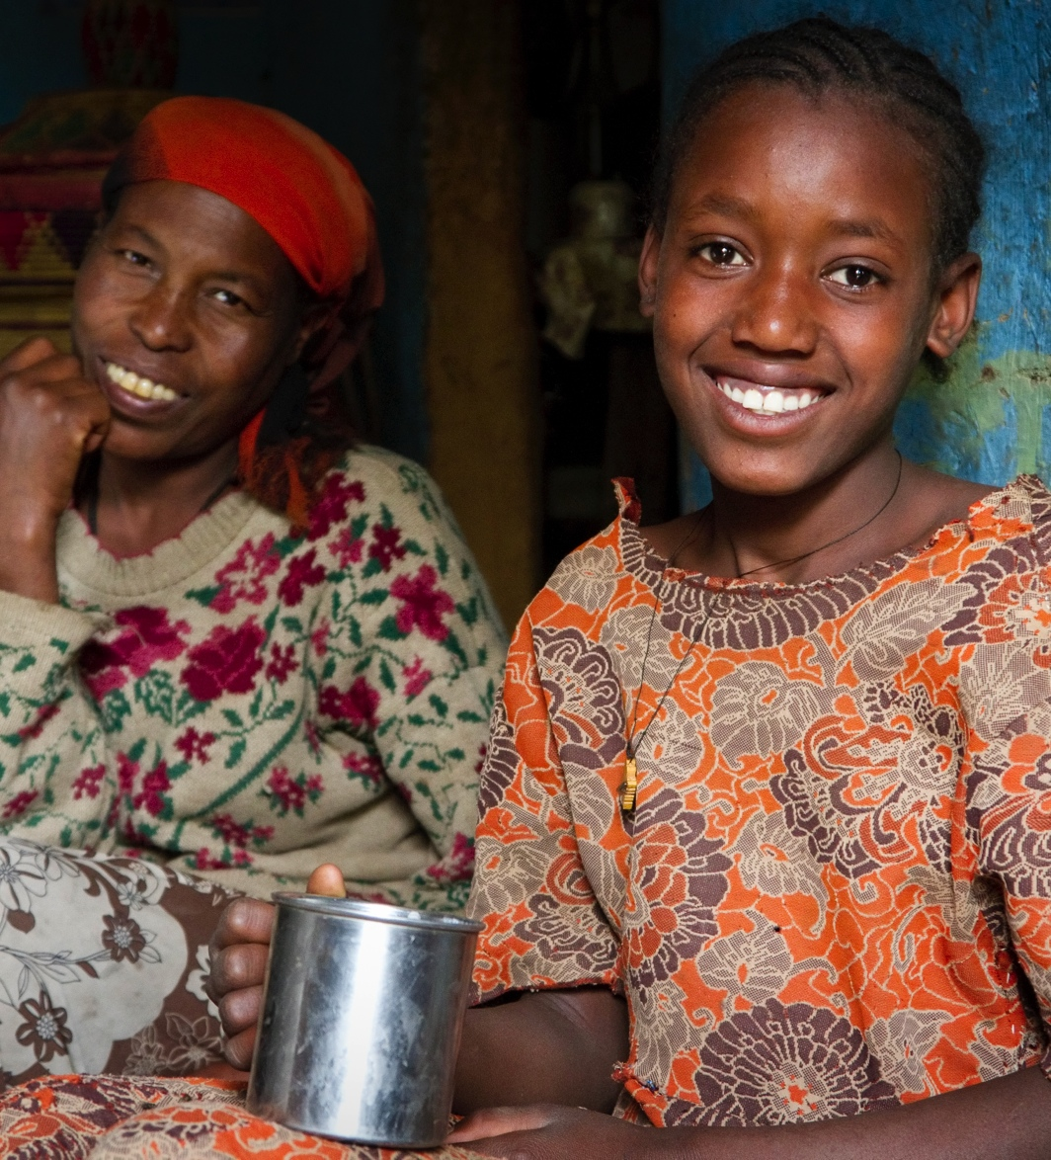
TITLE GOES HERE
& CAN RUN
THREE LINES
Level 1 bullet goes here.
  Level 2 bullet goes here.

Slide 5
DYNAMIC REGRESSION
F O R EC A S T I N G I N R
Z a hid A sg ha r
Professor, School of Economics, QAU
9/25/2022

Slide 6
DYNAMIC REGRESSION
Regression model with ARIMA errors:
y_{t} = β₀ + β₁x_{1,t} + ... + β_{r}x_{r,t} + e_{t}
y_{t} modeled as function of r explanatory variables x_{1,t}, ..., x_{r,t}

Slide 7
DYNAMIC REGRESSION
Regression model with ARIMA errors:
y_{t} = β₀ + β₁x_{1,t} + ... + β_{r}x_{r,t} + e_{t} ←
y_{t} modeled as function of r explanatory variables x_{1,t}, ..., x_{r,t}
In dynamic regression, we allow e_{t} to be an ARIMA process

Slide 8
DYNAMIC REGRESSION
Regression model with ARIMA errors:
y_{t} = β₀ + β₁x_{1,t} + ... + β_{r}x_{r,t} + e_{t}
y_{t} modeled as function of r explanatory variables x_{1,t}, ..., x_{r,t}
In dynamic regression, we allow e_{t} to be an ARIMA process
In ordinary regression, we assume that e_{t} is white noise

Slide 9
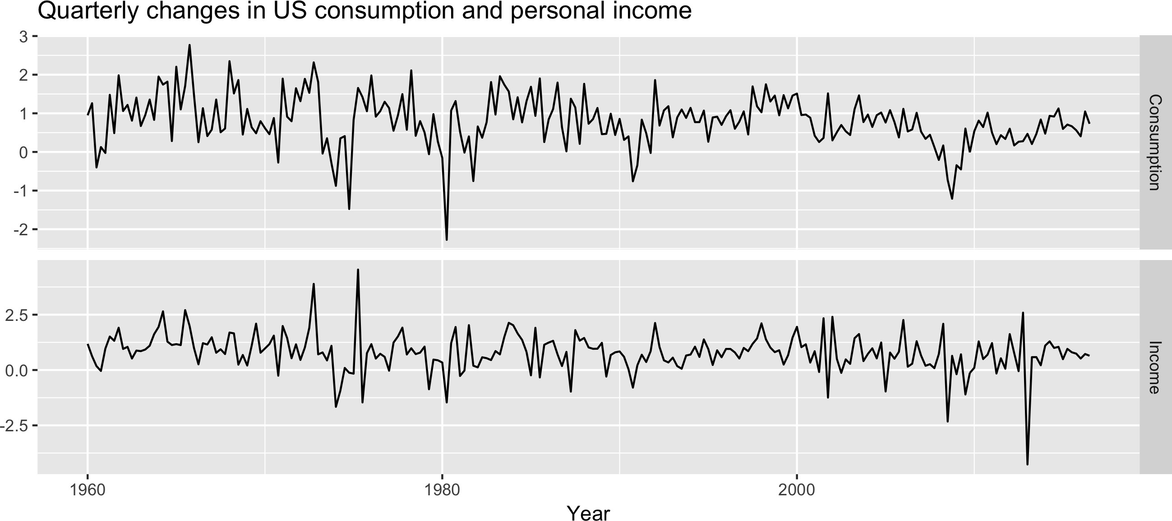
US PERSONAL CONSUMPTION AND INCOME
autoplot(uschange[,1:2], facets = TRUE) + xlab("Year") + ylab("") +
ggtitle("Quarterly changes in US consumption and personal income")

Slide 10
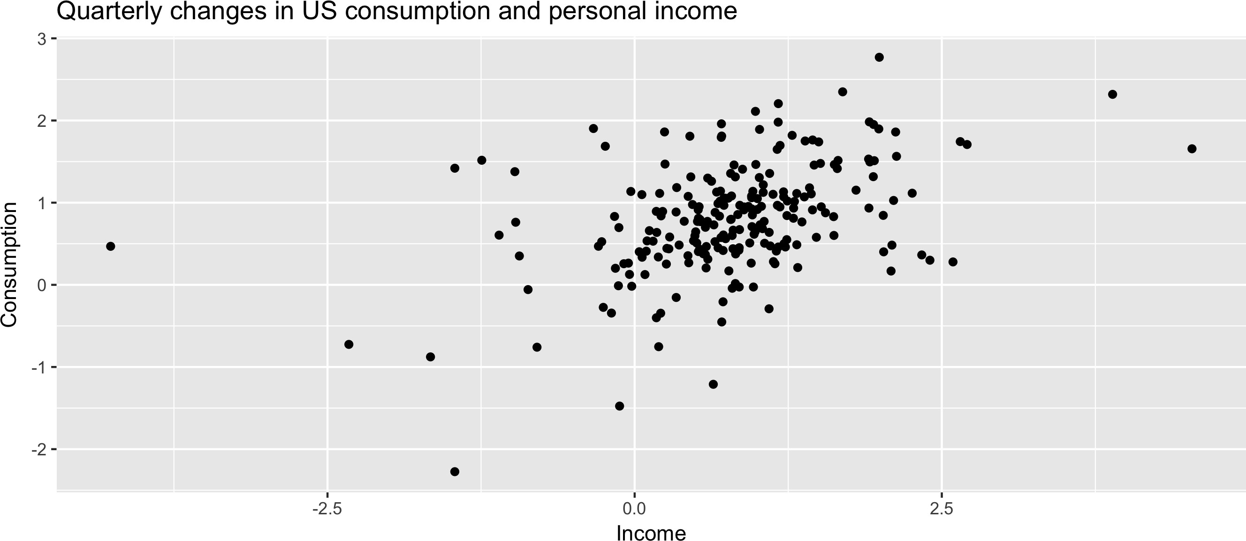
US PERSONAL CONSUMPTION AND INCOME
ggplot(aes(x = Income, y = Consumption), data = as.data.frame(uschange)) +
geom_point() +
ggtitle("Quarterly changes in US consumption and personal income")

Slide 11
DYNAMIC REGRESSION MODEL FOR US PERSONAL CONSUMPTION
fit <- auto.arima(uschange[,"Consumption"],
xreg = uschange[,"Income"])
fit
Series: uschange[, "Consumption"]
Regression with ARIMA(1,0,2) errors
Coefficients:
ar1 ma1 0.6191 -0.5424
0.1422 0.1475
intercept
0.6099
0.0777
origxreg 0.2492
0.0459
ma2 0.2367
0.0685
s.e.
sigma^2 estimated as 0.334:
log likelihood=-195.22
AIC=402.44 AICc=402.82 BIC=422.99

Slide 12
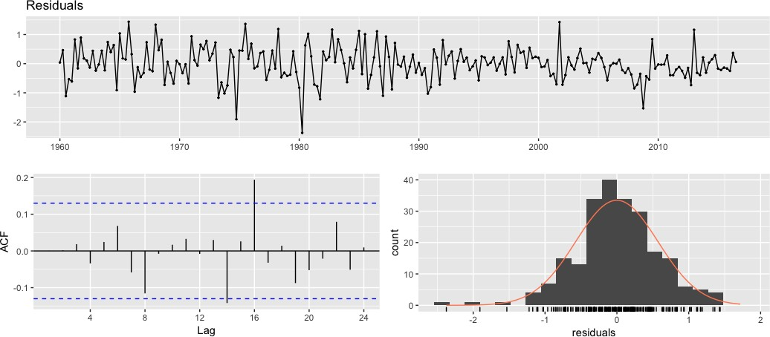
RESIDUALS FROM DYNAMIC REGRESSION MODEL
checkresiduals(fit)
Ljung-Box test
data: residuals
Q* = 5.5543, df = 3, p-value = 0.1354
Model df: 5. Total lags used: 8

Slide 13
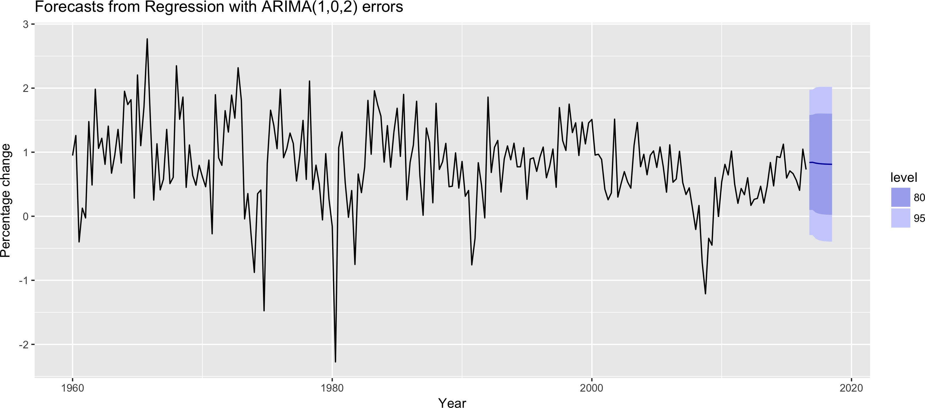
FORECASTS FROM DYNAMIC REGRESSION MODEL
fcast <- forecast(fit, xreg = rep(0.8, 8)) autoplot(fcast) +
xlab("Year") + ylab("Percentage change")

Slide 14
Let's practice!
F O R EC A S T I N G I N R

Slide 15
DYNAMIC HARMONIC REGRESSION
F O R EC A S T I N G I N R
Z a hid A sg ha r
Professor, School of Economics, QAU
9/25/2022

Slide 16
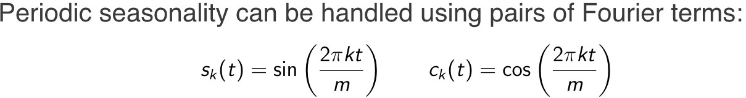
DYNAMIC HARMONIC REGRESSION

Slide 17
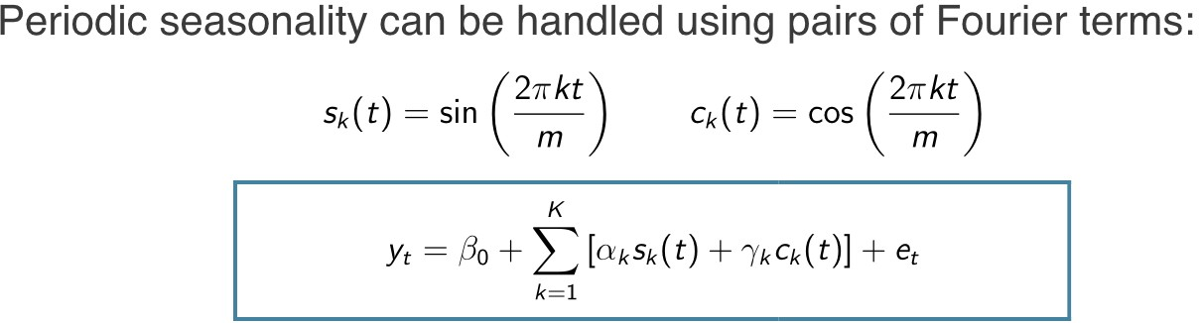
DYNAMIC HARMONIC REGRESSION
m = seasonal period
Every periodic function can be approximated by sums of sin and cos terms for large enough K
Regression coe cients: α_{k} and γ_{k}
e_{t} can be modeled as a non-seasonal ARIMA process
Assumes seasonal pa ern is unchanging

Slide 18
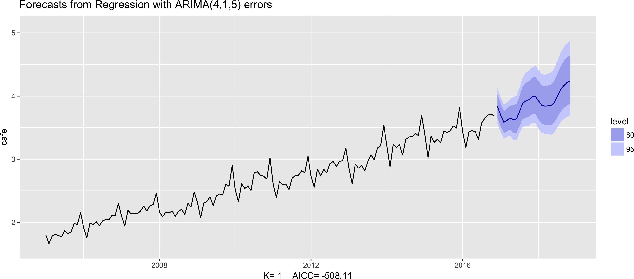
EXAMPLE: AUSTRALIAN CAFE EXPENDITURE
fit <- auto.arima(cafe, xreg = fourier(cafe, K = 1),
seasonal = FALSE, lambda = 0)
fit %>% forecast(xreg = fourier(cafe, K = 1, h = 24)) %>%
autoplot() + ylim(1.6, 5.1)

Slide 19
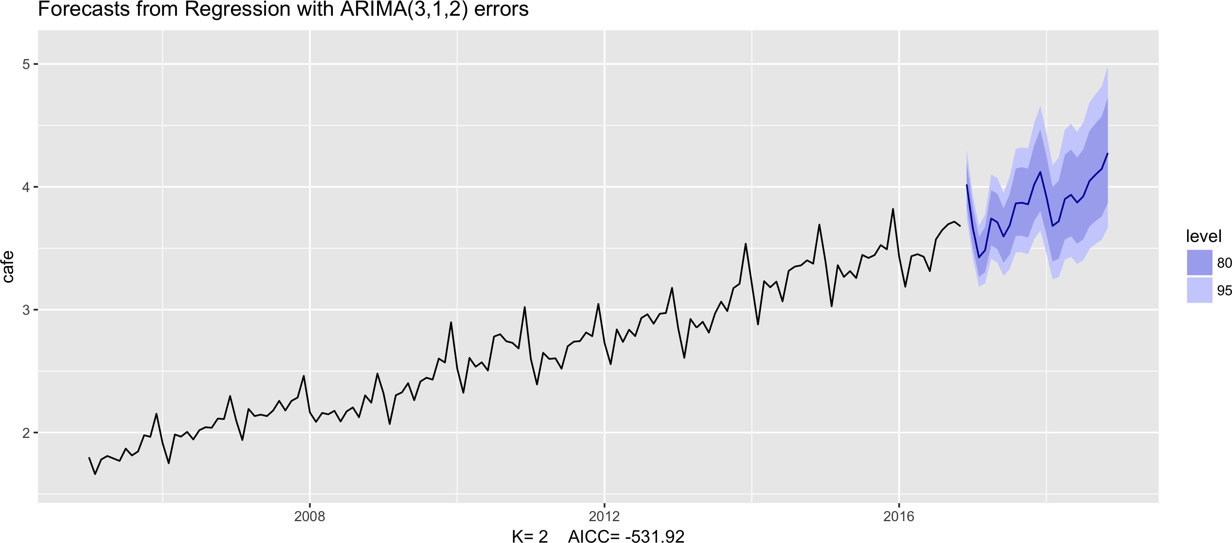
EXAMPLE: AUSTRALIAN CAFE EXPENDITURE
fit <- auto.arima(cafe, xreg = fourier(cafe, K = 1),
seasonal = FALSE, lambda = 0)
fit %>% forecast(xreg = fourier(cafe, K = 1, h = 24)) %>%
autoplot() + ylim(1.6, 5.1)

Slide 20
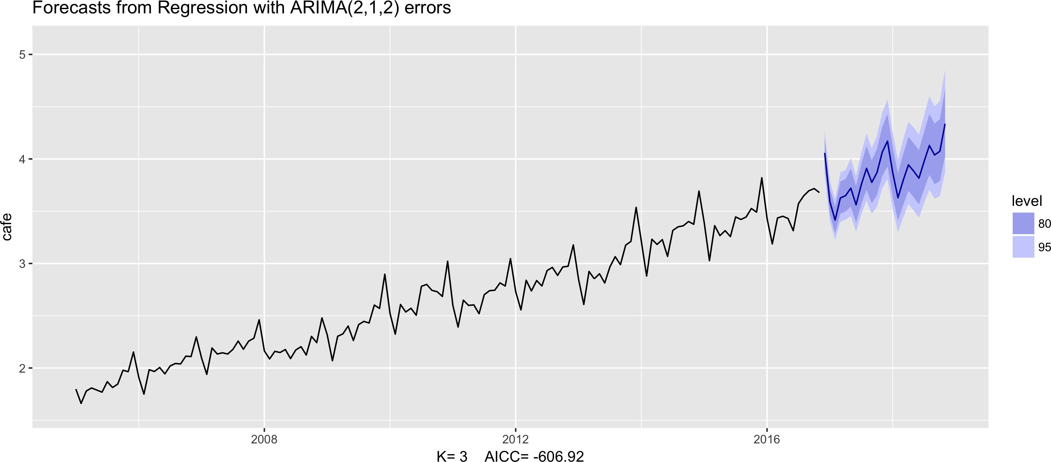
EXAMPLE: AUSTRALIAN CAFE EXPENDITURE
fit <- auto.arima(cafe, xreg = fourier(cafe, K = 1),
seasonal = FALSE, lambda = 0)
fit %>% forecast(xreg = fourier(cafe, K = 1, h = 24)) %>%
autoplot() + ylim(1.6, 5.1)

Slide 21
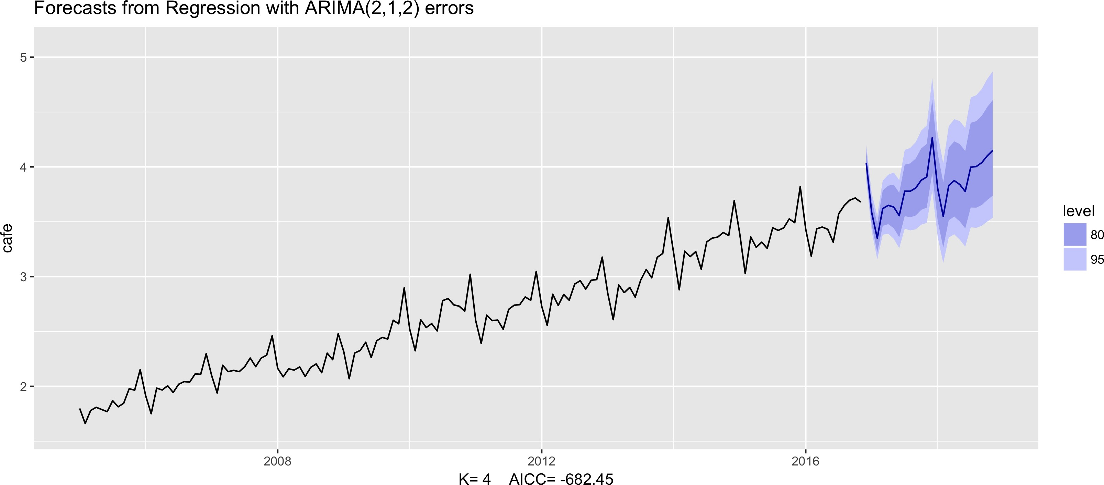
EXAMPLE: AUSTRALIAN CAFE EXPENDITURE
fit <- auto.arima(cafe, xreg = fourier(cafe, K = 1),
seasonal = FALSE, lambda = 0)
fit %>% forecast(xreg = fourier(cafe, K = 1, h = 24)) %>%
autoplot() + ylim(1.6, 5.1)

Slide 22
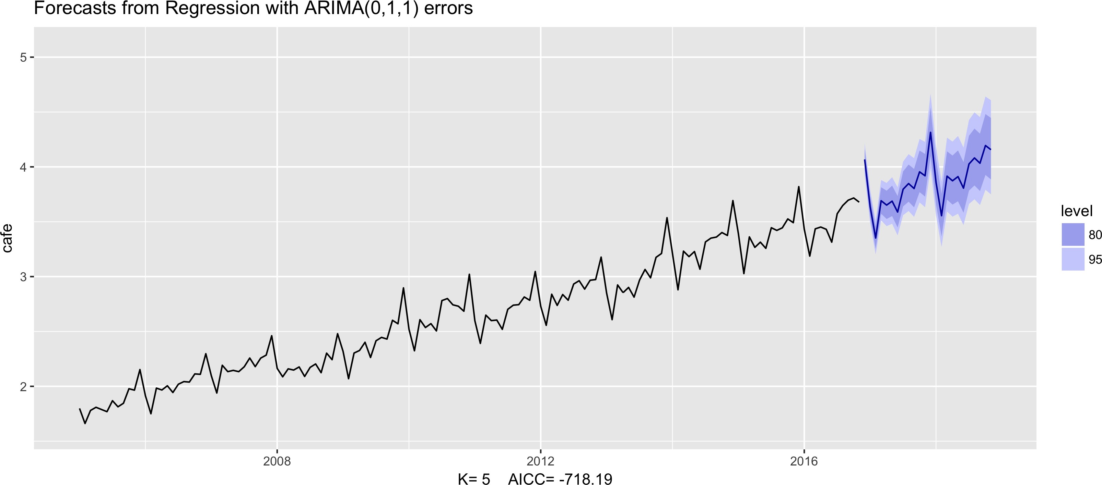
EXAMPLE: AUSTRALIAN CAFE EXPENDITURE
fit <- auto.arima(cafe, xreg = fourier(cafe, K = 1),
seasonal = FALSE, lambda = 0)
fit %>% forecast(xreg = fourier(cafe, K = 1, h = 24)) %>%
autoplot() + ylim(1.6, 5.1)

Slide 23

EXAMPLE: AUSTRALIAN CAFE EXPENDITURE
fit <- auto.arima(cafe, xreg = fourier(cafe, K = 1),
seasonal = FALSE, lambda = 0)
fit %>% forecast(xreg = fourier(cafe, K = 1, h = 24)) %>%
autoplot() + ylim(1.6, 5.1)

Slide 24
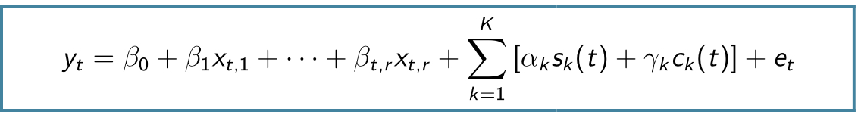
DYNAMIC HARMONIC REGRESSION
Other predictor variables can be added as well: x_{t,1}, ..., x_{t,r}
Choose K to minimize the AIC_{c}
K can not be more than m/2
This is particularly useful for weekly data, daily data and sub- daily data.

Slide 25
Let's practice!
F O R EC A S T I N G I N R

Slide 26
T
TBATS MODEL
F O R EC A S T I N G I N R
Z a hid A sg ha r
Professor, School of Economics, QAU
9/25/2022

Slide 27
TBATS MODEL
Trigonometric terms for seasonality
Box-Cox transformations for heterogeneity
ARMA errors for short-term dynamics
Trend (possibly damped)
Seasonal (including multiple and non-integer periods)

Slide 28
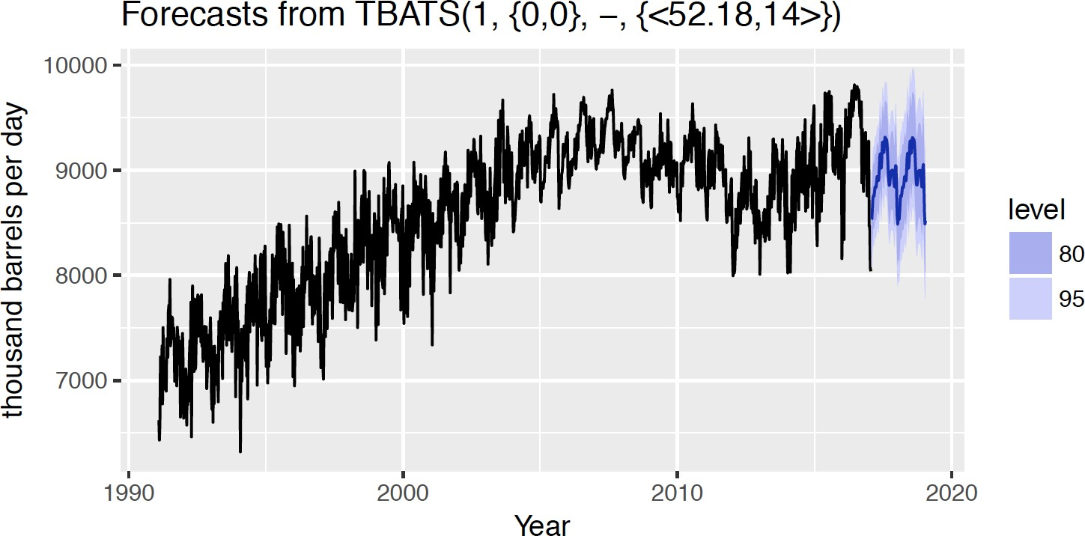
US GASOLINE DATA
gasoline %>% tbats() %>% forecast() %>% autoplot() +
xlab("Year") + ylab("thousand barrels per day")

Slide 29
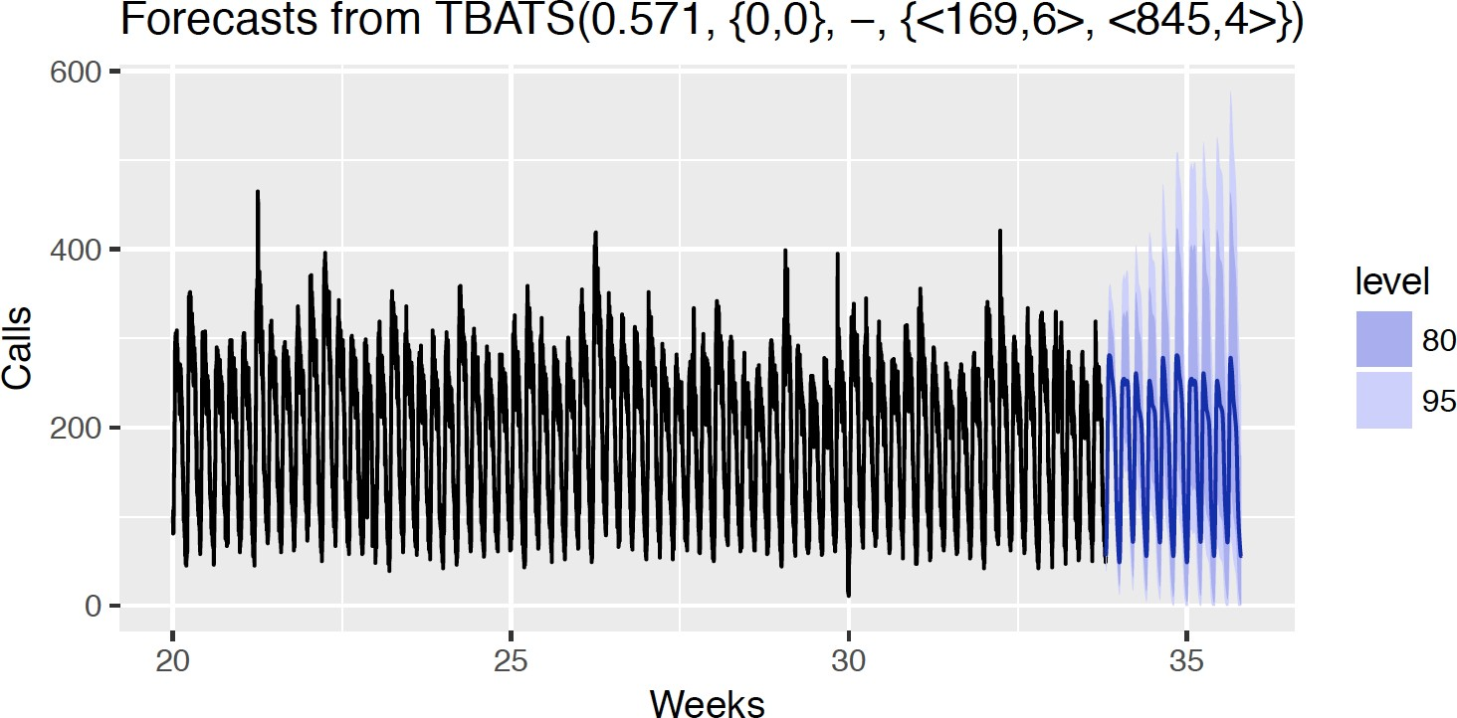
CALL CENTER DATA
calls %>% window(start = 20) %>% tbats() %>% forecast() %>%
autoplot() + xlab("Weeks") + ylab("Calls")

Slide 30
TBATS MODEL
Trigonometric terms for seasonality
Box-Cox transformations for heterogeneity
ARMA errors for short-term dynamics
Trend (possibly damped)
Seasonal (including multiple and non-integer periods)
Handles non-integer seasonality, multiple seasonal periods
Entirely automated
Prediction intervals o en too wide
Very slow on long series

Slide 31
Let's practice!
F O R EC A S T I N G I N R

Slide 32
T
YOUR FUTURE IN FORECASTING!
F O R EC A S T I N G I N R
Z a hid A sg ha r
Professor, School of Economics, QAU
9/25/2022

Slide 33
THESE SLIDES FROM DATACAMP
Other DataCamp courses:
ARIMA modeling with R Introduction to Time Series Analysis
Manipulating Time Series Data in R with xts and zoo

Slide 34

YOUR FUTURE IN FORECASTING
Practice forecasting lots of di erent time series, using many di erent methods

Slide 35
Let's practice!
F O R EC A S T I N G I N R

